Slide 1
Walk Behind Mower Replacement
Mark Eagar
Dominic Couch
9/23/24

Slide 2
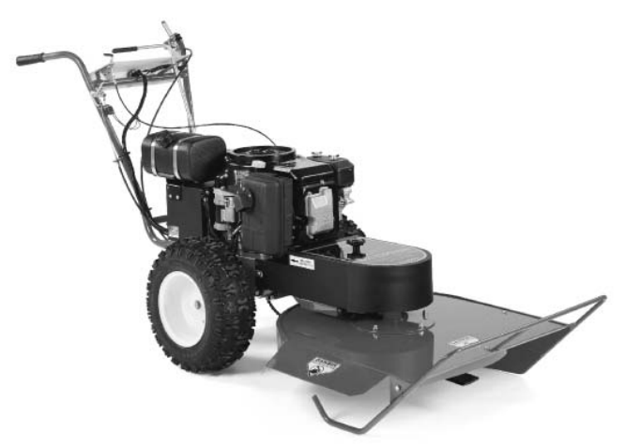
Mower replacement
Walk behind single blade mower is at end of life (DR All Terrain Field and Brush Mower)
Wearing out, currently not functional (broken cables, belts, drive pulley, loose gears on transmission, engine burning oil)
Repair will just push the replacement problem down the road
Walk behind is critical for precision mowing around lights, signs, and along fence line for fire break.
Tractor does not have maneuverability required to mow these areas
8,000 ft of runway edge and light trimming, ~12,000 ft of fencelines
Wide deck is also nearing end of life and is not as effective for mowing around lights
Less maneuverable, less effective mower

Slide 3
Options Considered
Purchase new zero turn mower – residential models modestly priced, expected lifetime 5-8 years
Budgetted $7,000.00 for purchase,
Additional 7300 budgeted for repairs and parts replacement
However, California rule changes have eliminated gas powered residential mowers
Contacted Lowe’s, John Deer, Husqevarna, Home Depo. no gas powered residential mowers available.
Electric mower does not have anywhere near the battery life to mow the size of our airport runway and fence perimeter.
Need to look at other options

Slide 4
Mower replacement Options
Looked at used mowers, many available
Unknown condition
No warranty
Would have to pay cash for it
Contacted local landscaping equipment dealer,
They have 1 commercial zero turn mower (stand on) available
They cannot get anymore, limited to existing inventory only (2023 equipment)
Higher price, but better quality and more suited for our airport site
Contacted Sacramento Husqevarna Dealer and requested information about commercial mower
They did not respond with a quote

Slide 5
Commercial Zero Turn Mower Option
Toro zero turn stand on mower (can also be walk behind)
Commercial unit, 2 ½ year warranty, 5 yr with modest additional cost
Substantially better quality than residential models
Better precision mowing than sit on residential versions
Used for cemeteries and other areas with tight mowing requirements similar to our runway lights
List price 12,000
Toro fall special 11,000
Option to finance some or all at zero % for 48 months
Consider surplusing existing walk behinds (repare single blade) and sell to offset some of the cost of the new mower

Slide 6
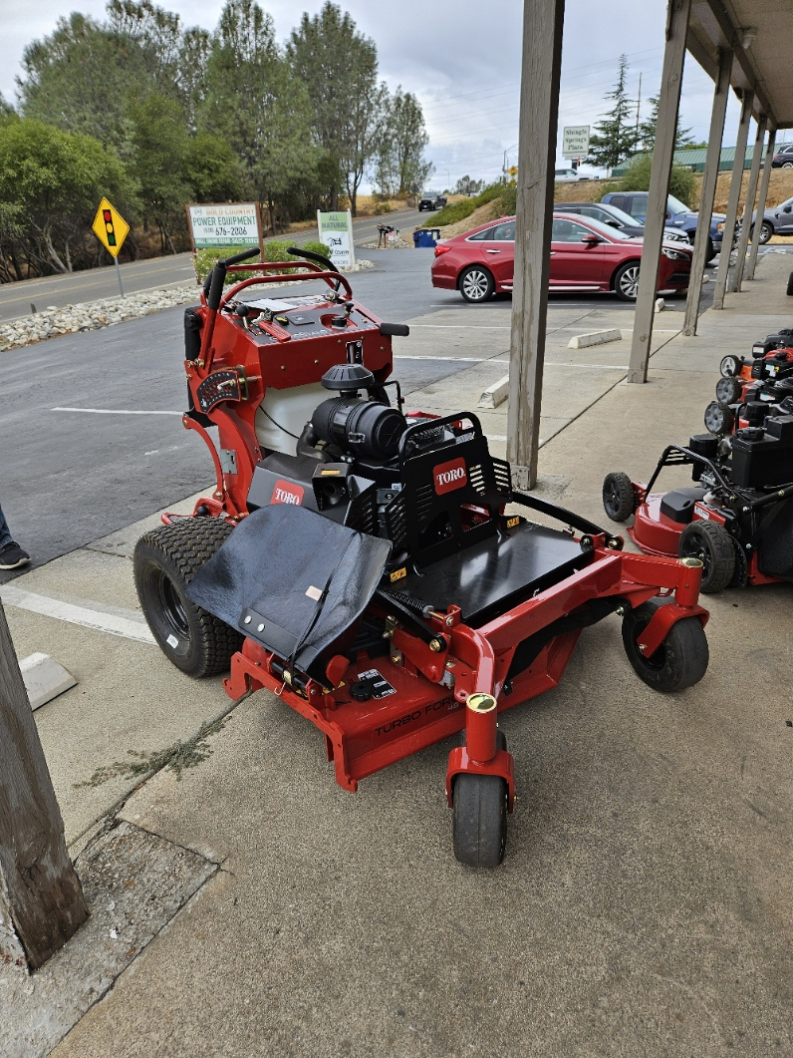

Slide 7
Recommendation
Recommend purchase Toro commercial zero turn mower to replace DR all terrain walk behind.
Options include:
7000 down (current budget) and finance remaining 4000 over 4 years
83.00 a month
Pay cash (plus up mower replacement budget from 7000 to 11000)
Looking for Board vote and approval tonight so we can proceed with purchase
Needed immediately for trimming around lights as it is due again.

Slide 8
From: Mark Eagar <markeagar@msn.com> Sent: Tuesday, September 3, 2024 2:16 PM To: Airport Manager <manager@cameronparkairport.org>; Terry Bohlen <tabohlen@gmail.com>; Greg Wright <gwright@gforcesolutions.com> Subject: lawn mower replacement options for consideration
we have been trying to get the walk behind (single blade) that we use to mow around the lights repaired since the cable broke. We have discovered the following problems:
Blade engagement cable damaged (need to replace)
Transmission dry and drive wheel sprocket gear worn/loose
Blade belt pulley damaged, possible damage to crankshaft key slot
blade drive belt damaged
The mower appears to be nearing the end of its useful life and I recommend we look at replacing it with a zero turn mower, which is about the same price.
Here are some options I have found for consideration:
Phil suggested we talk to the john deer dealer about possibly taking our mower deck in as trade credit against a mower. Let me know what you think.
Mark

Slide 9
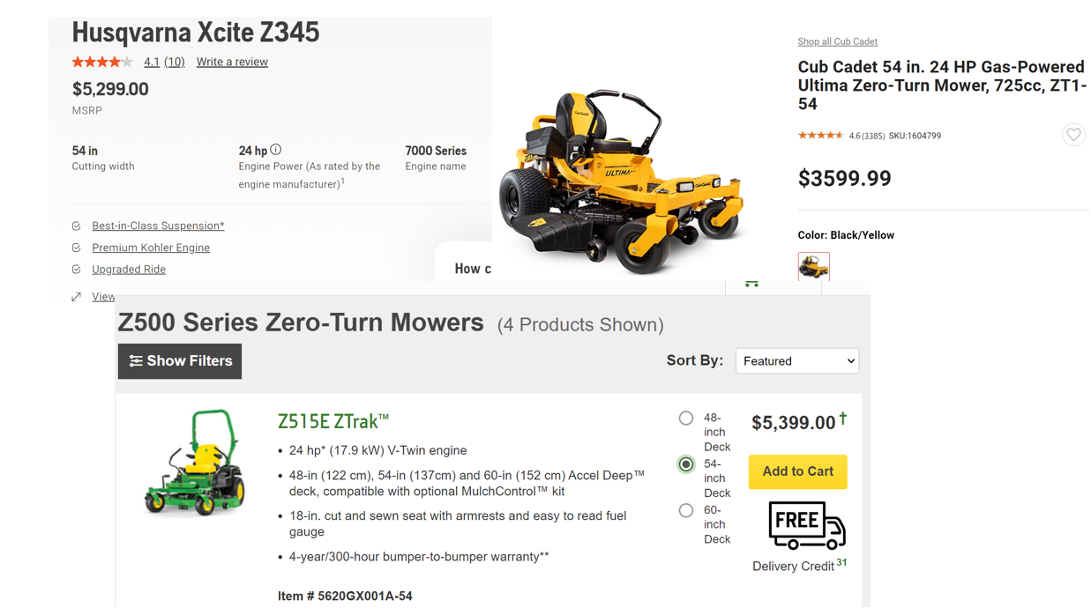
Not available in California

Slide 10
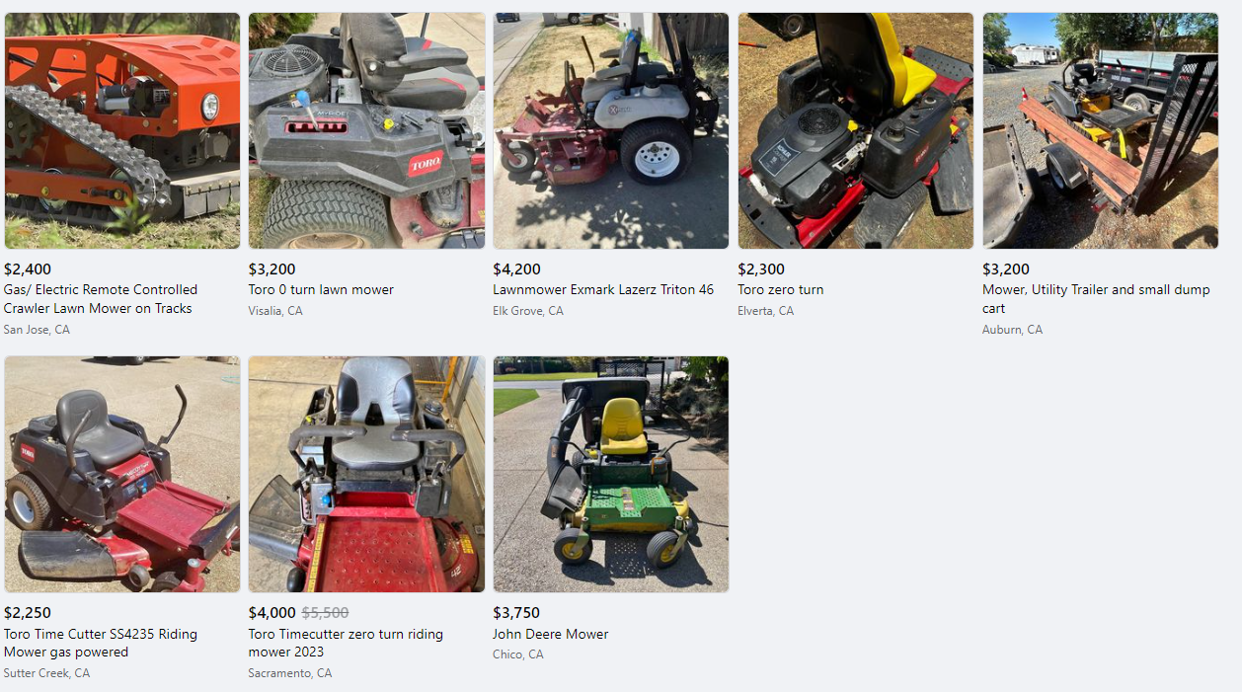
Snapshot facebook marketplace
Used zero turn residential mowers

